Slide 1
Reliable transmission Protocols
Stop and Wait ARQ
Sliding Window Protocol
Sliding window protocol has two types:
Go-Back-N ARQ
Selective Repeat ARQ

Slide 2
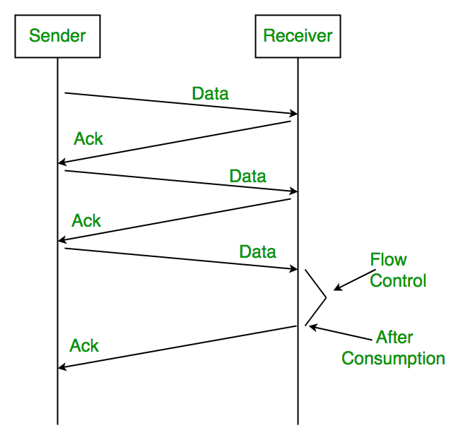
Stop and Wait ARQ
Used in Connection-oriented communication.
It offers error and flows control
Simple Stop and Wait

Slide 3
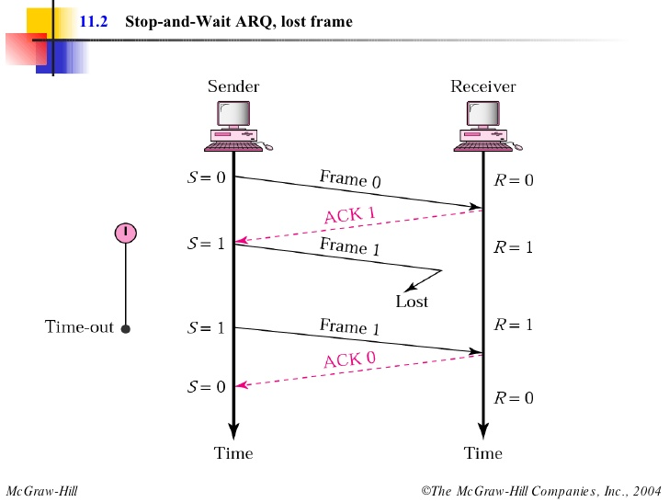

Slide 4
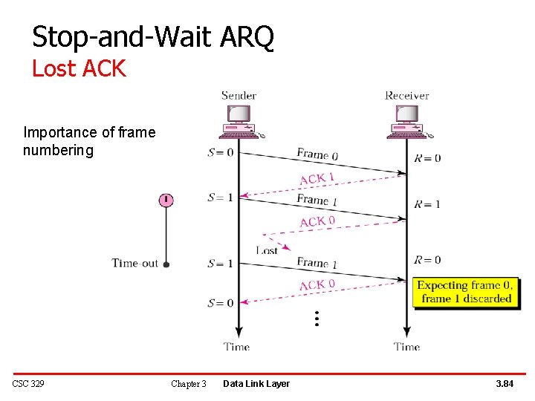

Slide 5
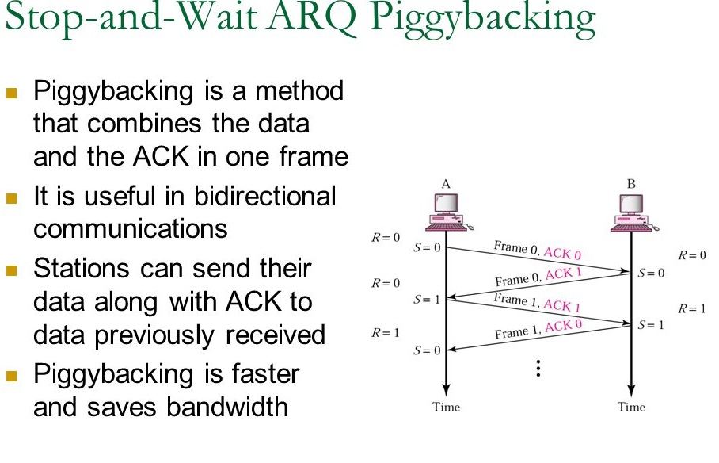

Slide 6
Sliding Window Protocol
The sliding window is a technique for sending multiple frames at a time.
Sliding window protocol has two types:
Go-Back-N ARQ
Selective Repeat ARQ

Slide 7
Go-Back-N ARQ
Go-Back-N ARQ protocol is also known as Go-Back-N Automatic Repeat Request.
It is a data link layer protocol that uses a sliding window method. In this, if any frame is corrupted or lost, all subsequent frames have to be sent again.
For example, Go-Back-8, the size of the sender window, will be 8. The receiver window size is always 1.

Slide 8
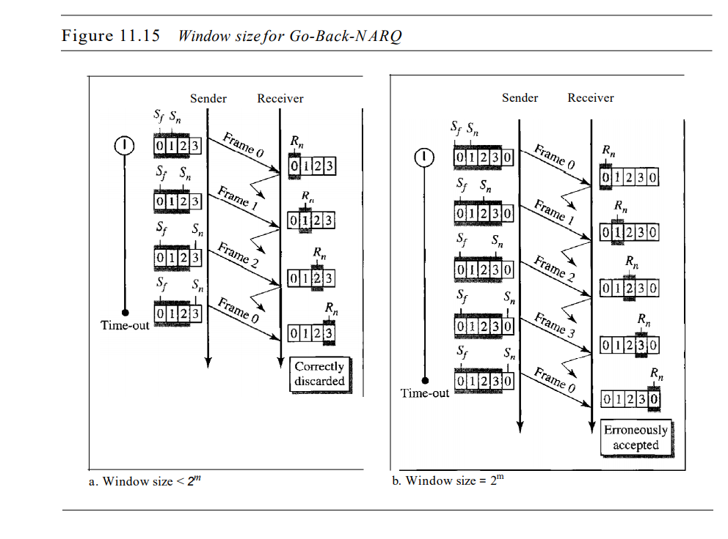

Slide 9
Selective Repeat ARQ
It is also known as the Selective Repeat Automatic Repeat Request.
It is a data link layer protocol that uses a sliding window method.
In this protocol, the size of the sender window is always equal to the size of the receiver window. The size of the sliding window is always greater than 1.

Slide 10
